Slide 1

User behavior analysis
Visualisation
Chabičovská, Šmíd, Zeman

Slide 2
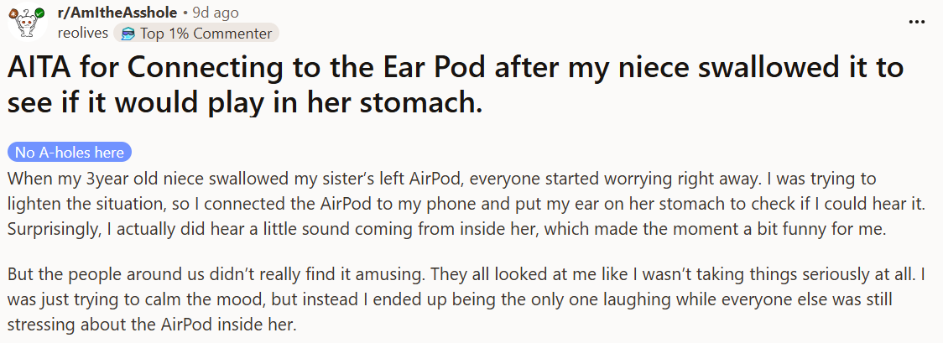
What is Reddit?
Online social media forum
Collection of topic-based communities (subreddits, boards)
Message board, threads
Ranking system - upvotes/downvotes

Slide 3
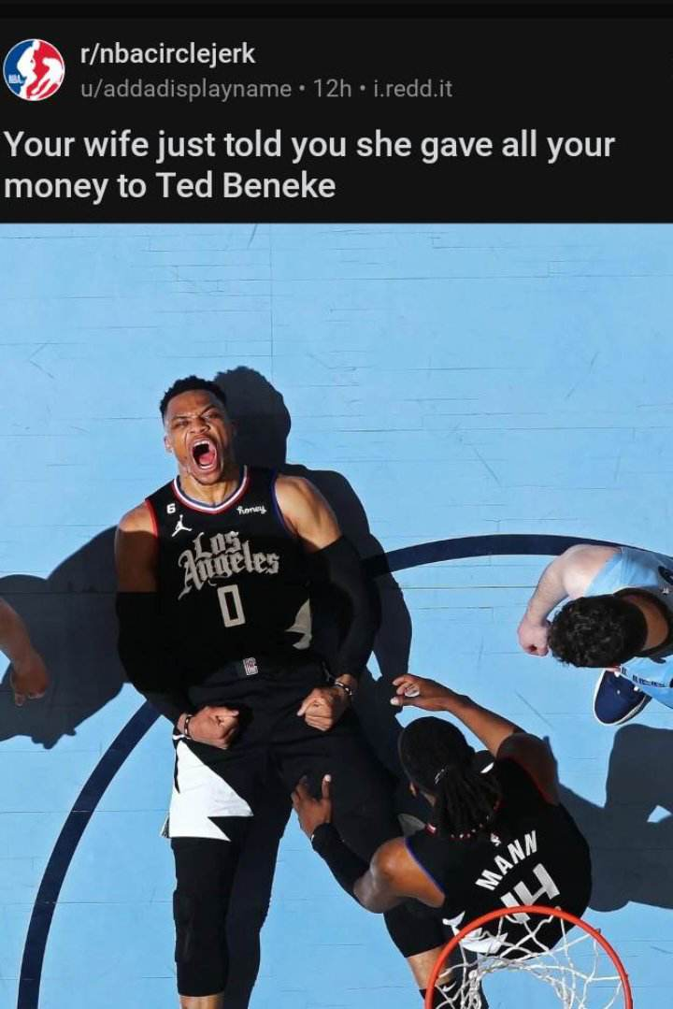
Data
Subreddits:
  Game of Thrones
  FreeFolk
  NBA
  NBACircleJerk

Slide 4
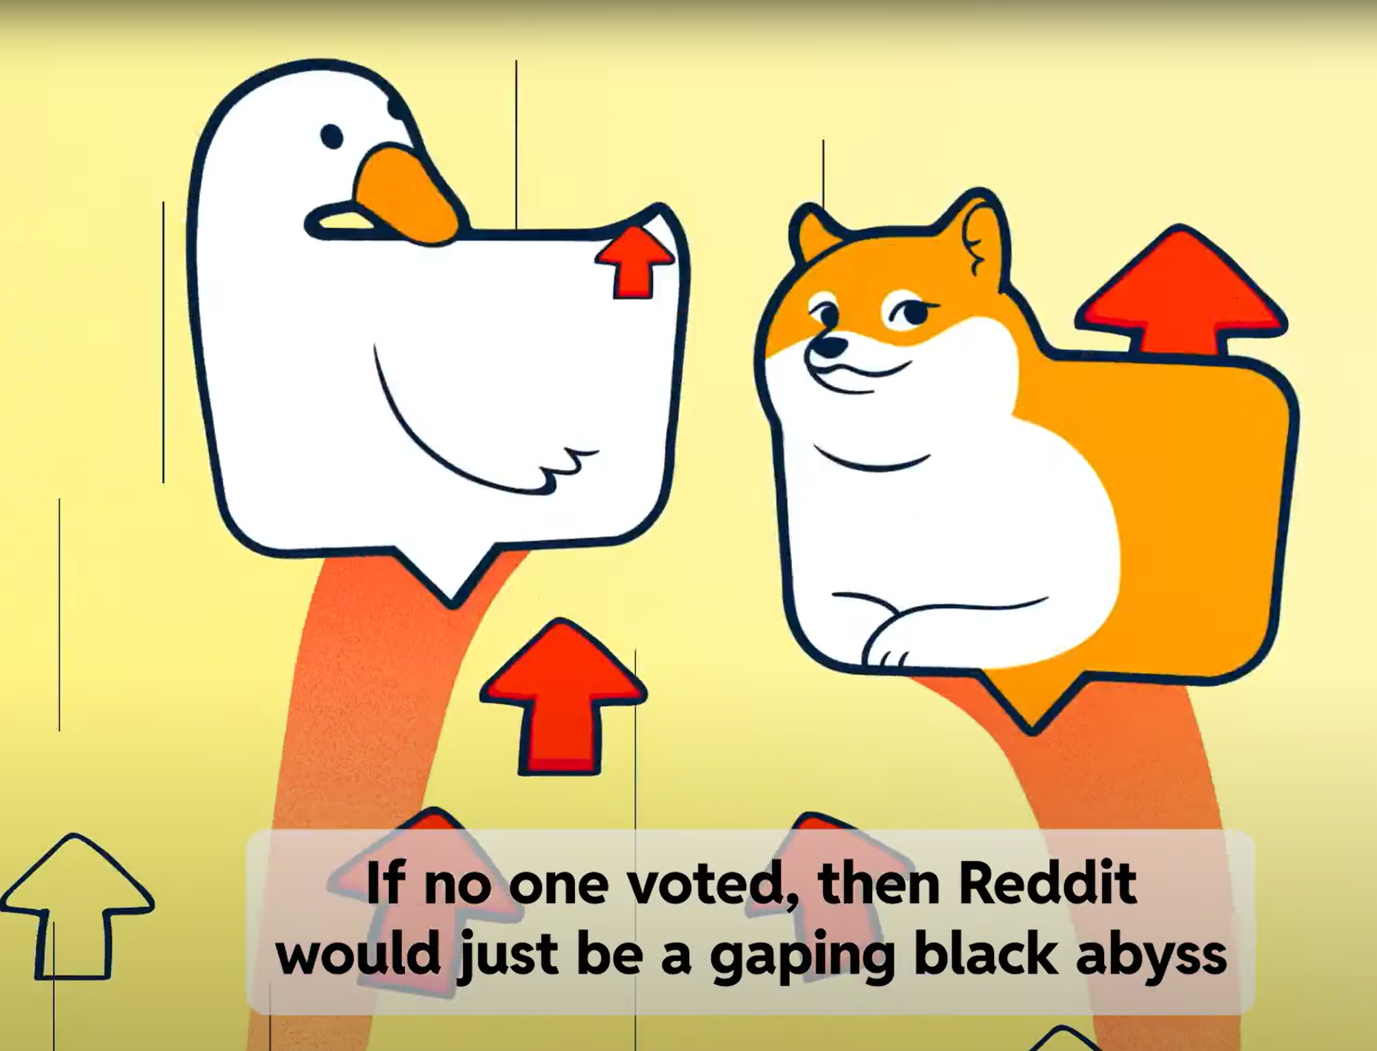
Data
Attributes:
  User score = # upvotes - # downvotes
  Date of posting
  Content of post
Lifespan of a subreddit
User activity

Slide 5
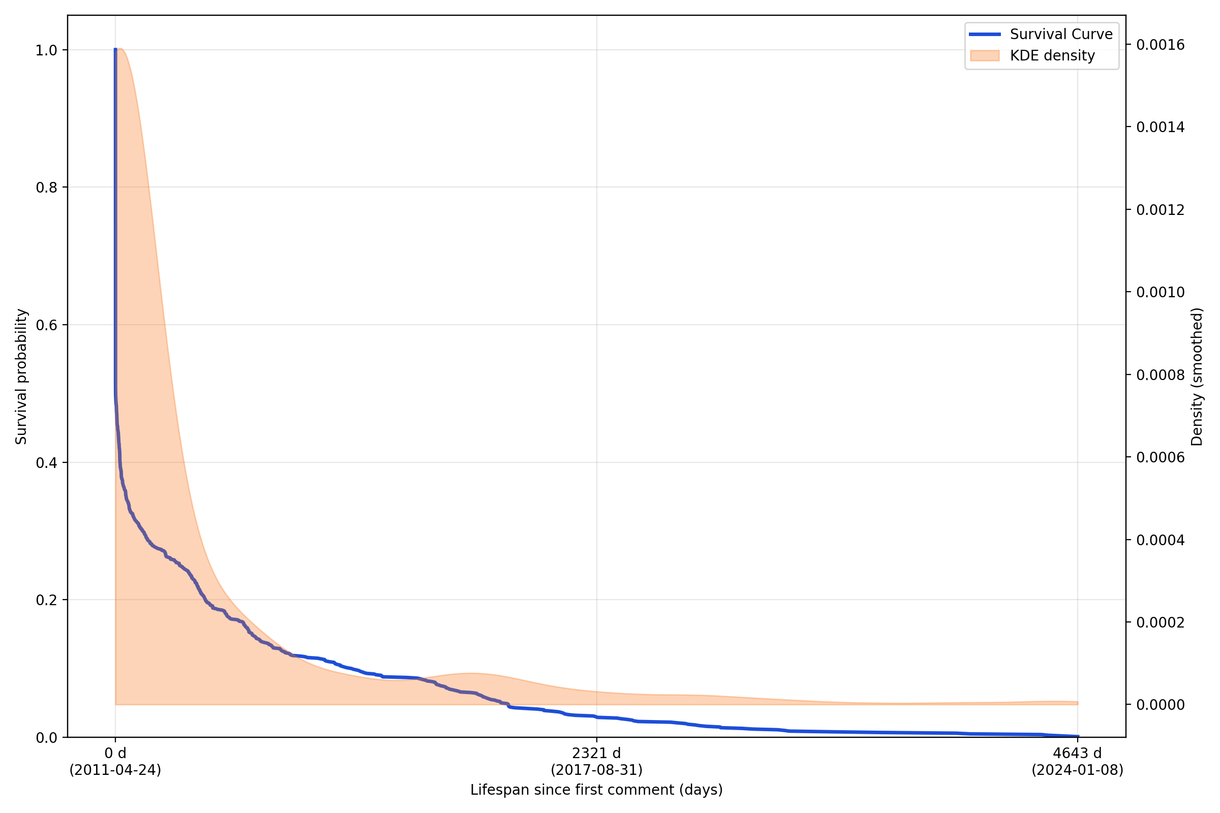
Lifespan

Slide 6
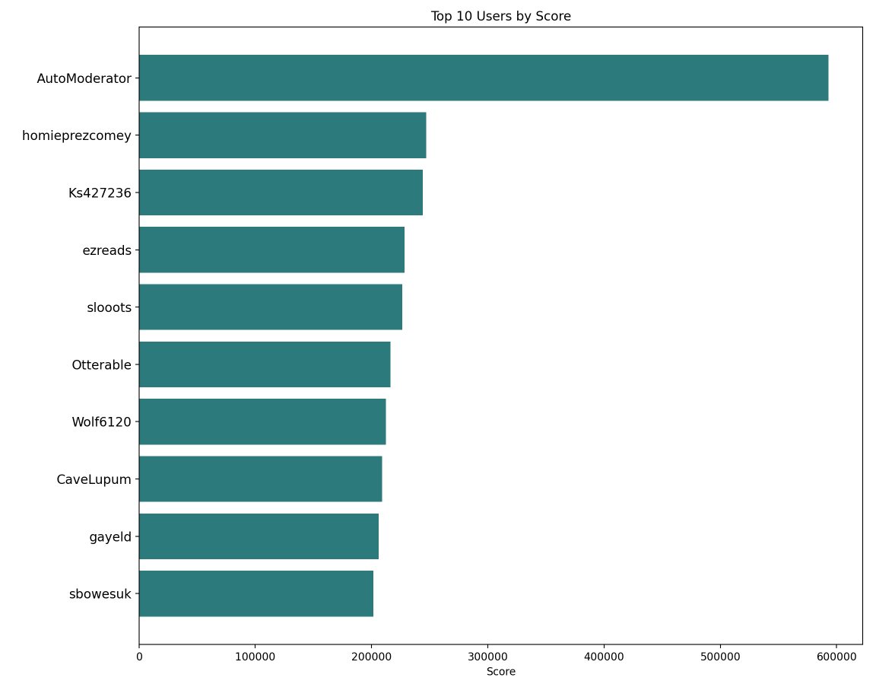
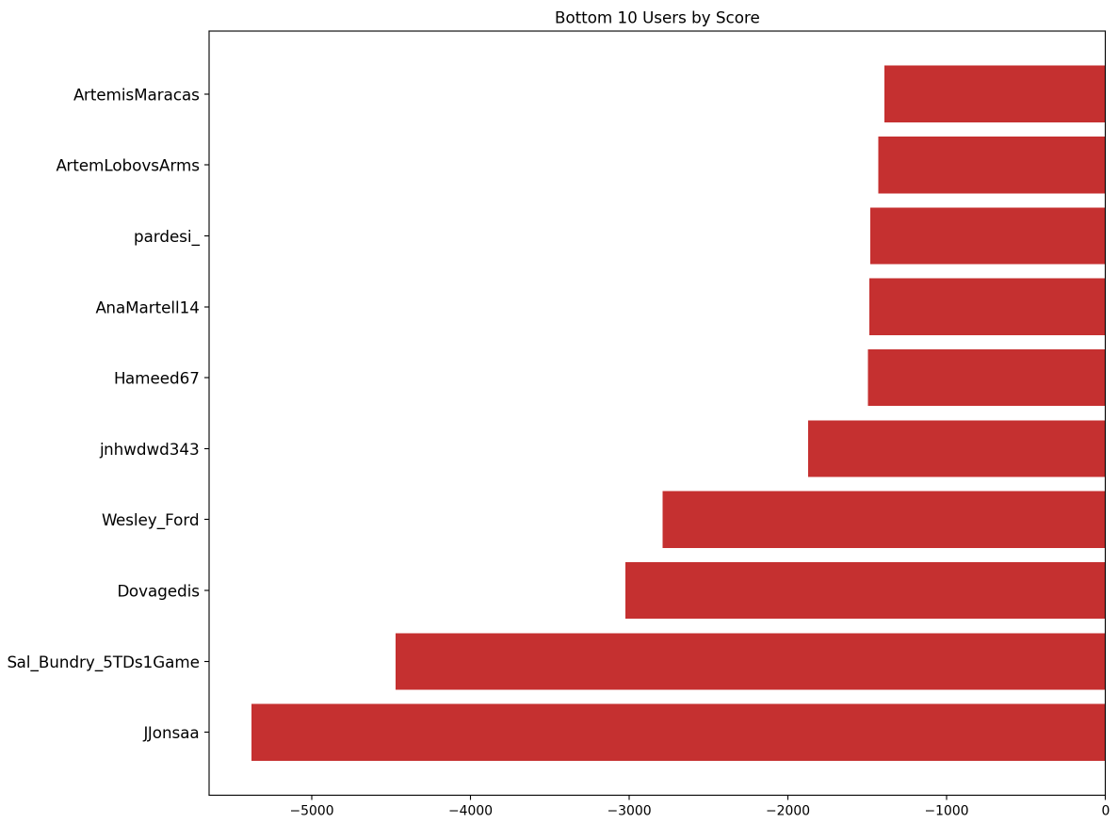
Min/max score

Slide 7
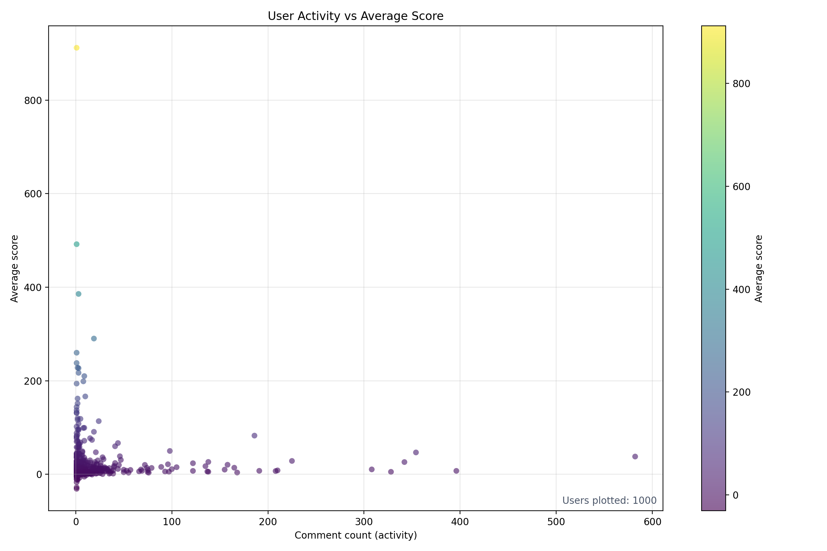
Activity vs Score

Slide 8
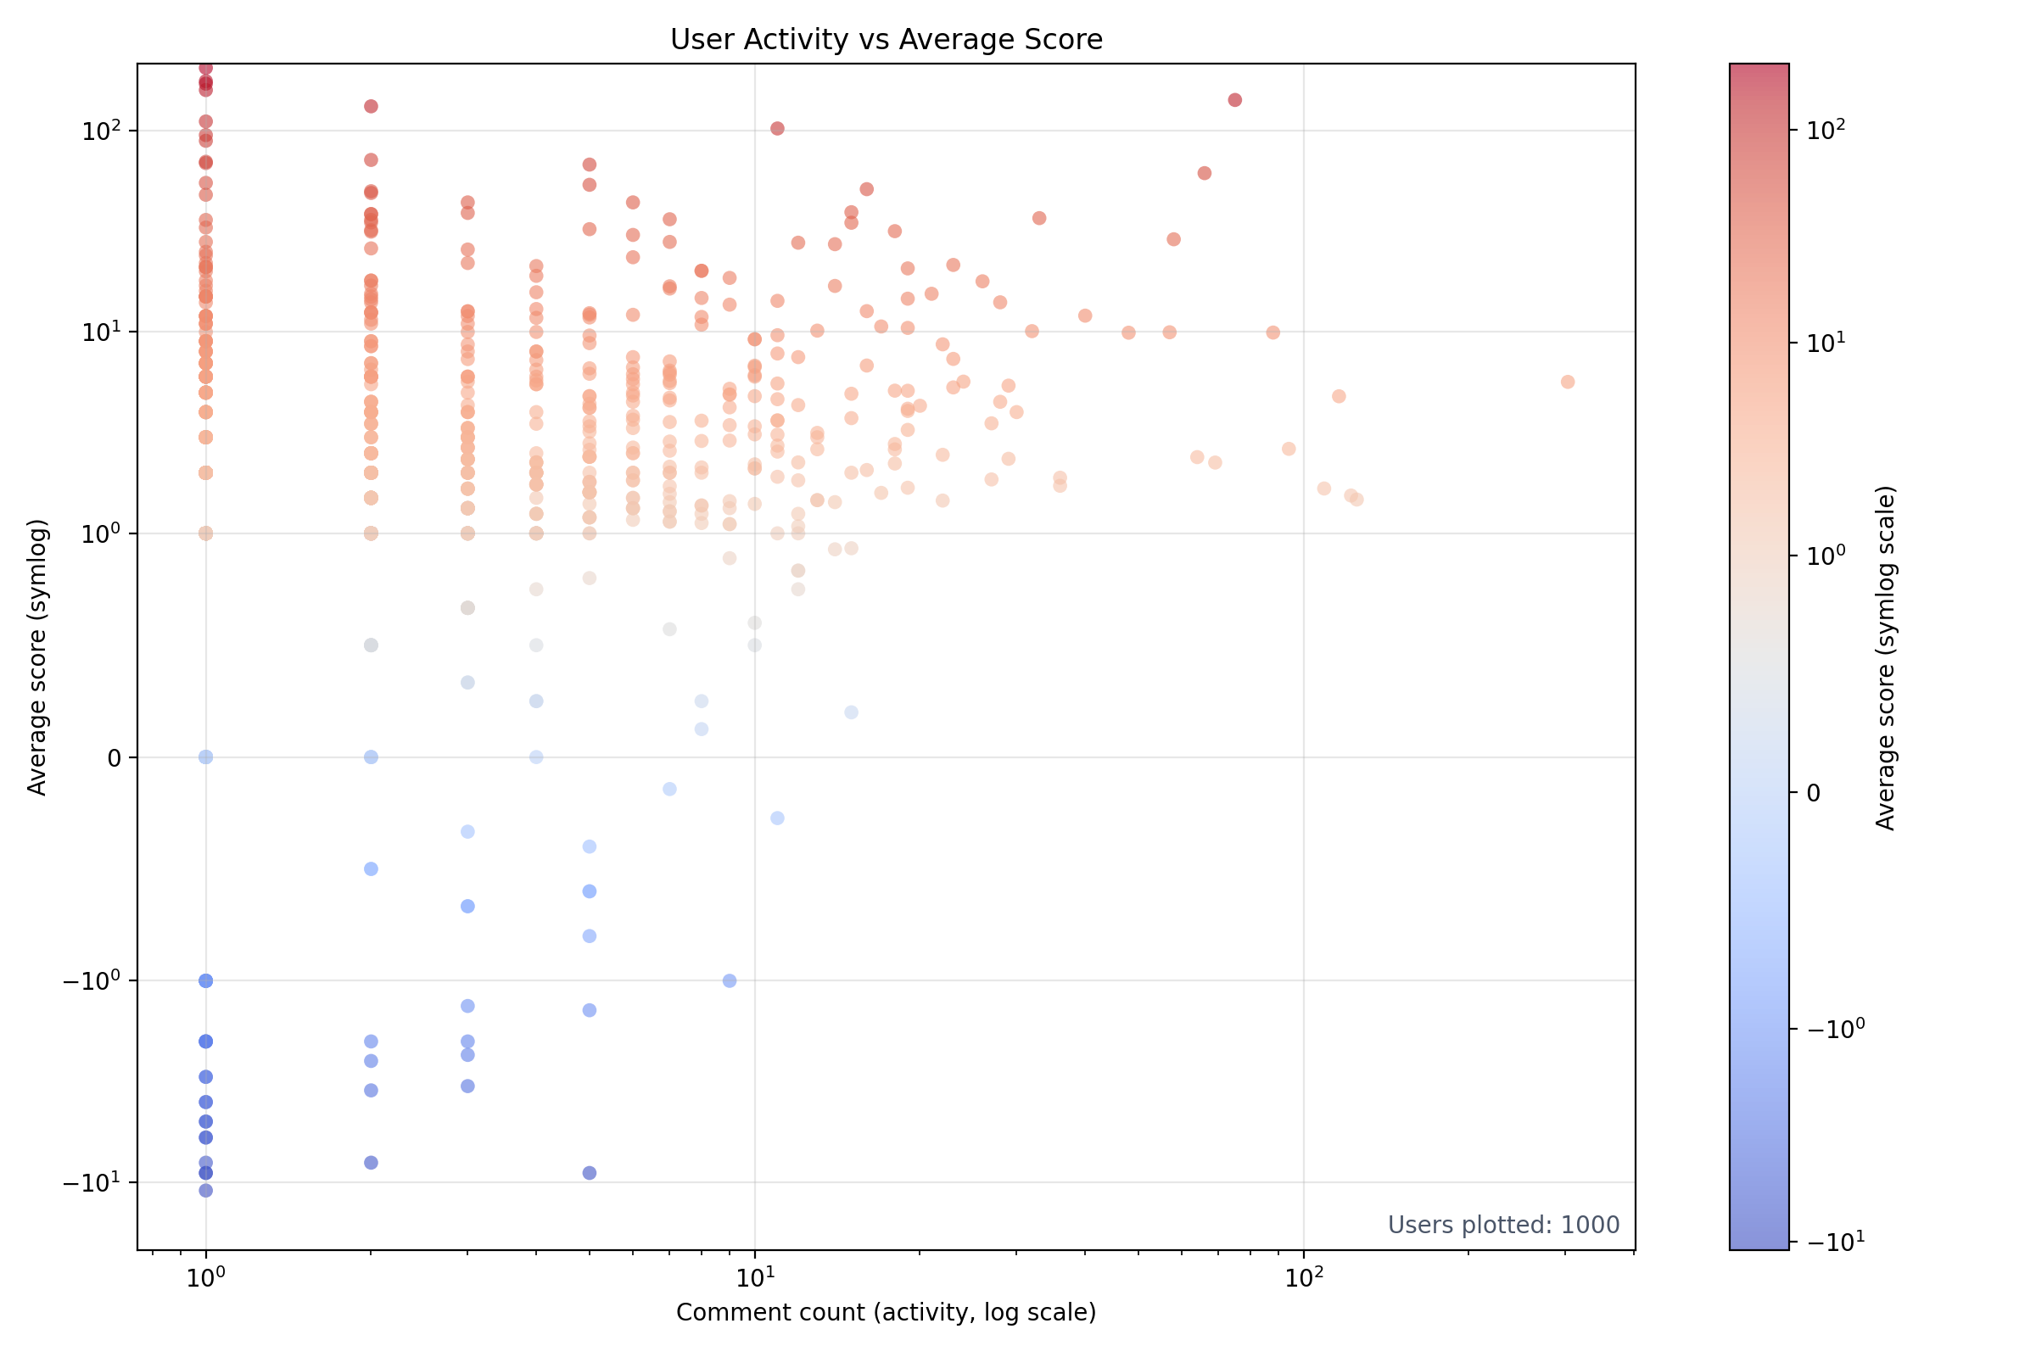
Sentiment contract

Slide 9
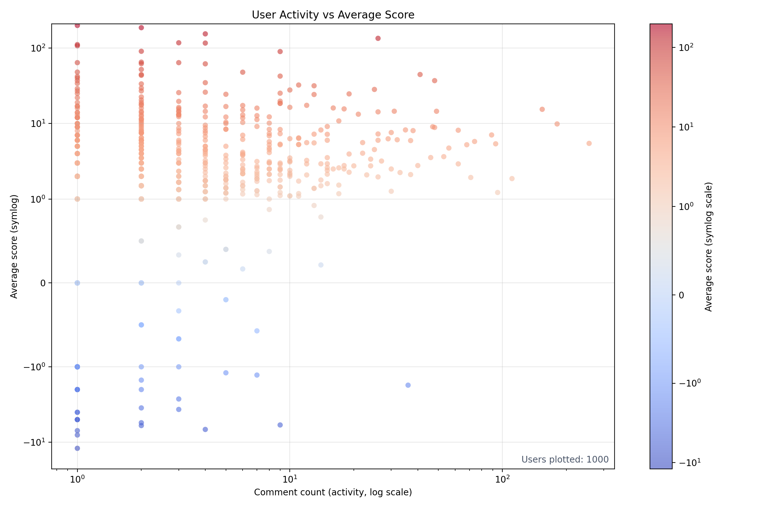
Sentiment contract r/Aww

Slide 10
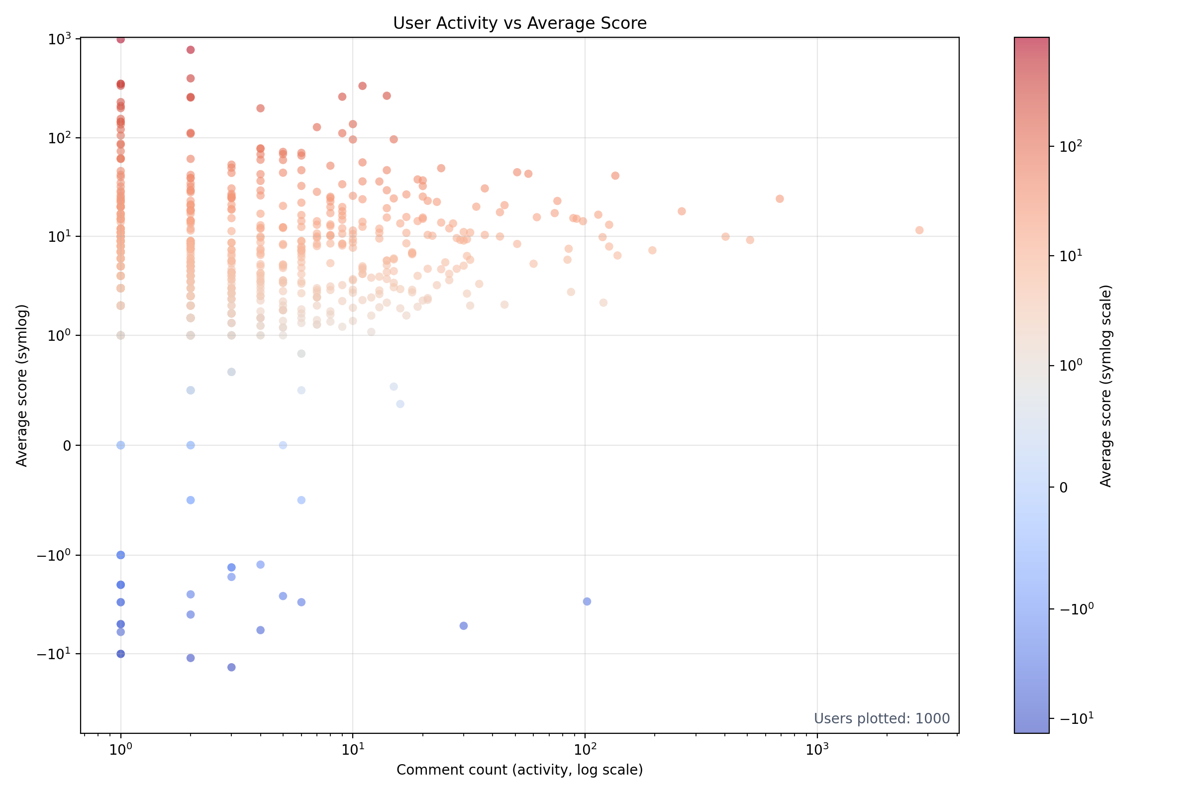
Sentiment contract r/GoT

Slide 11
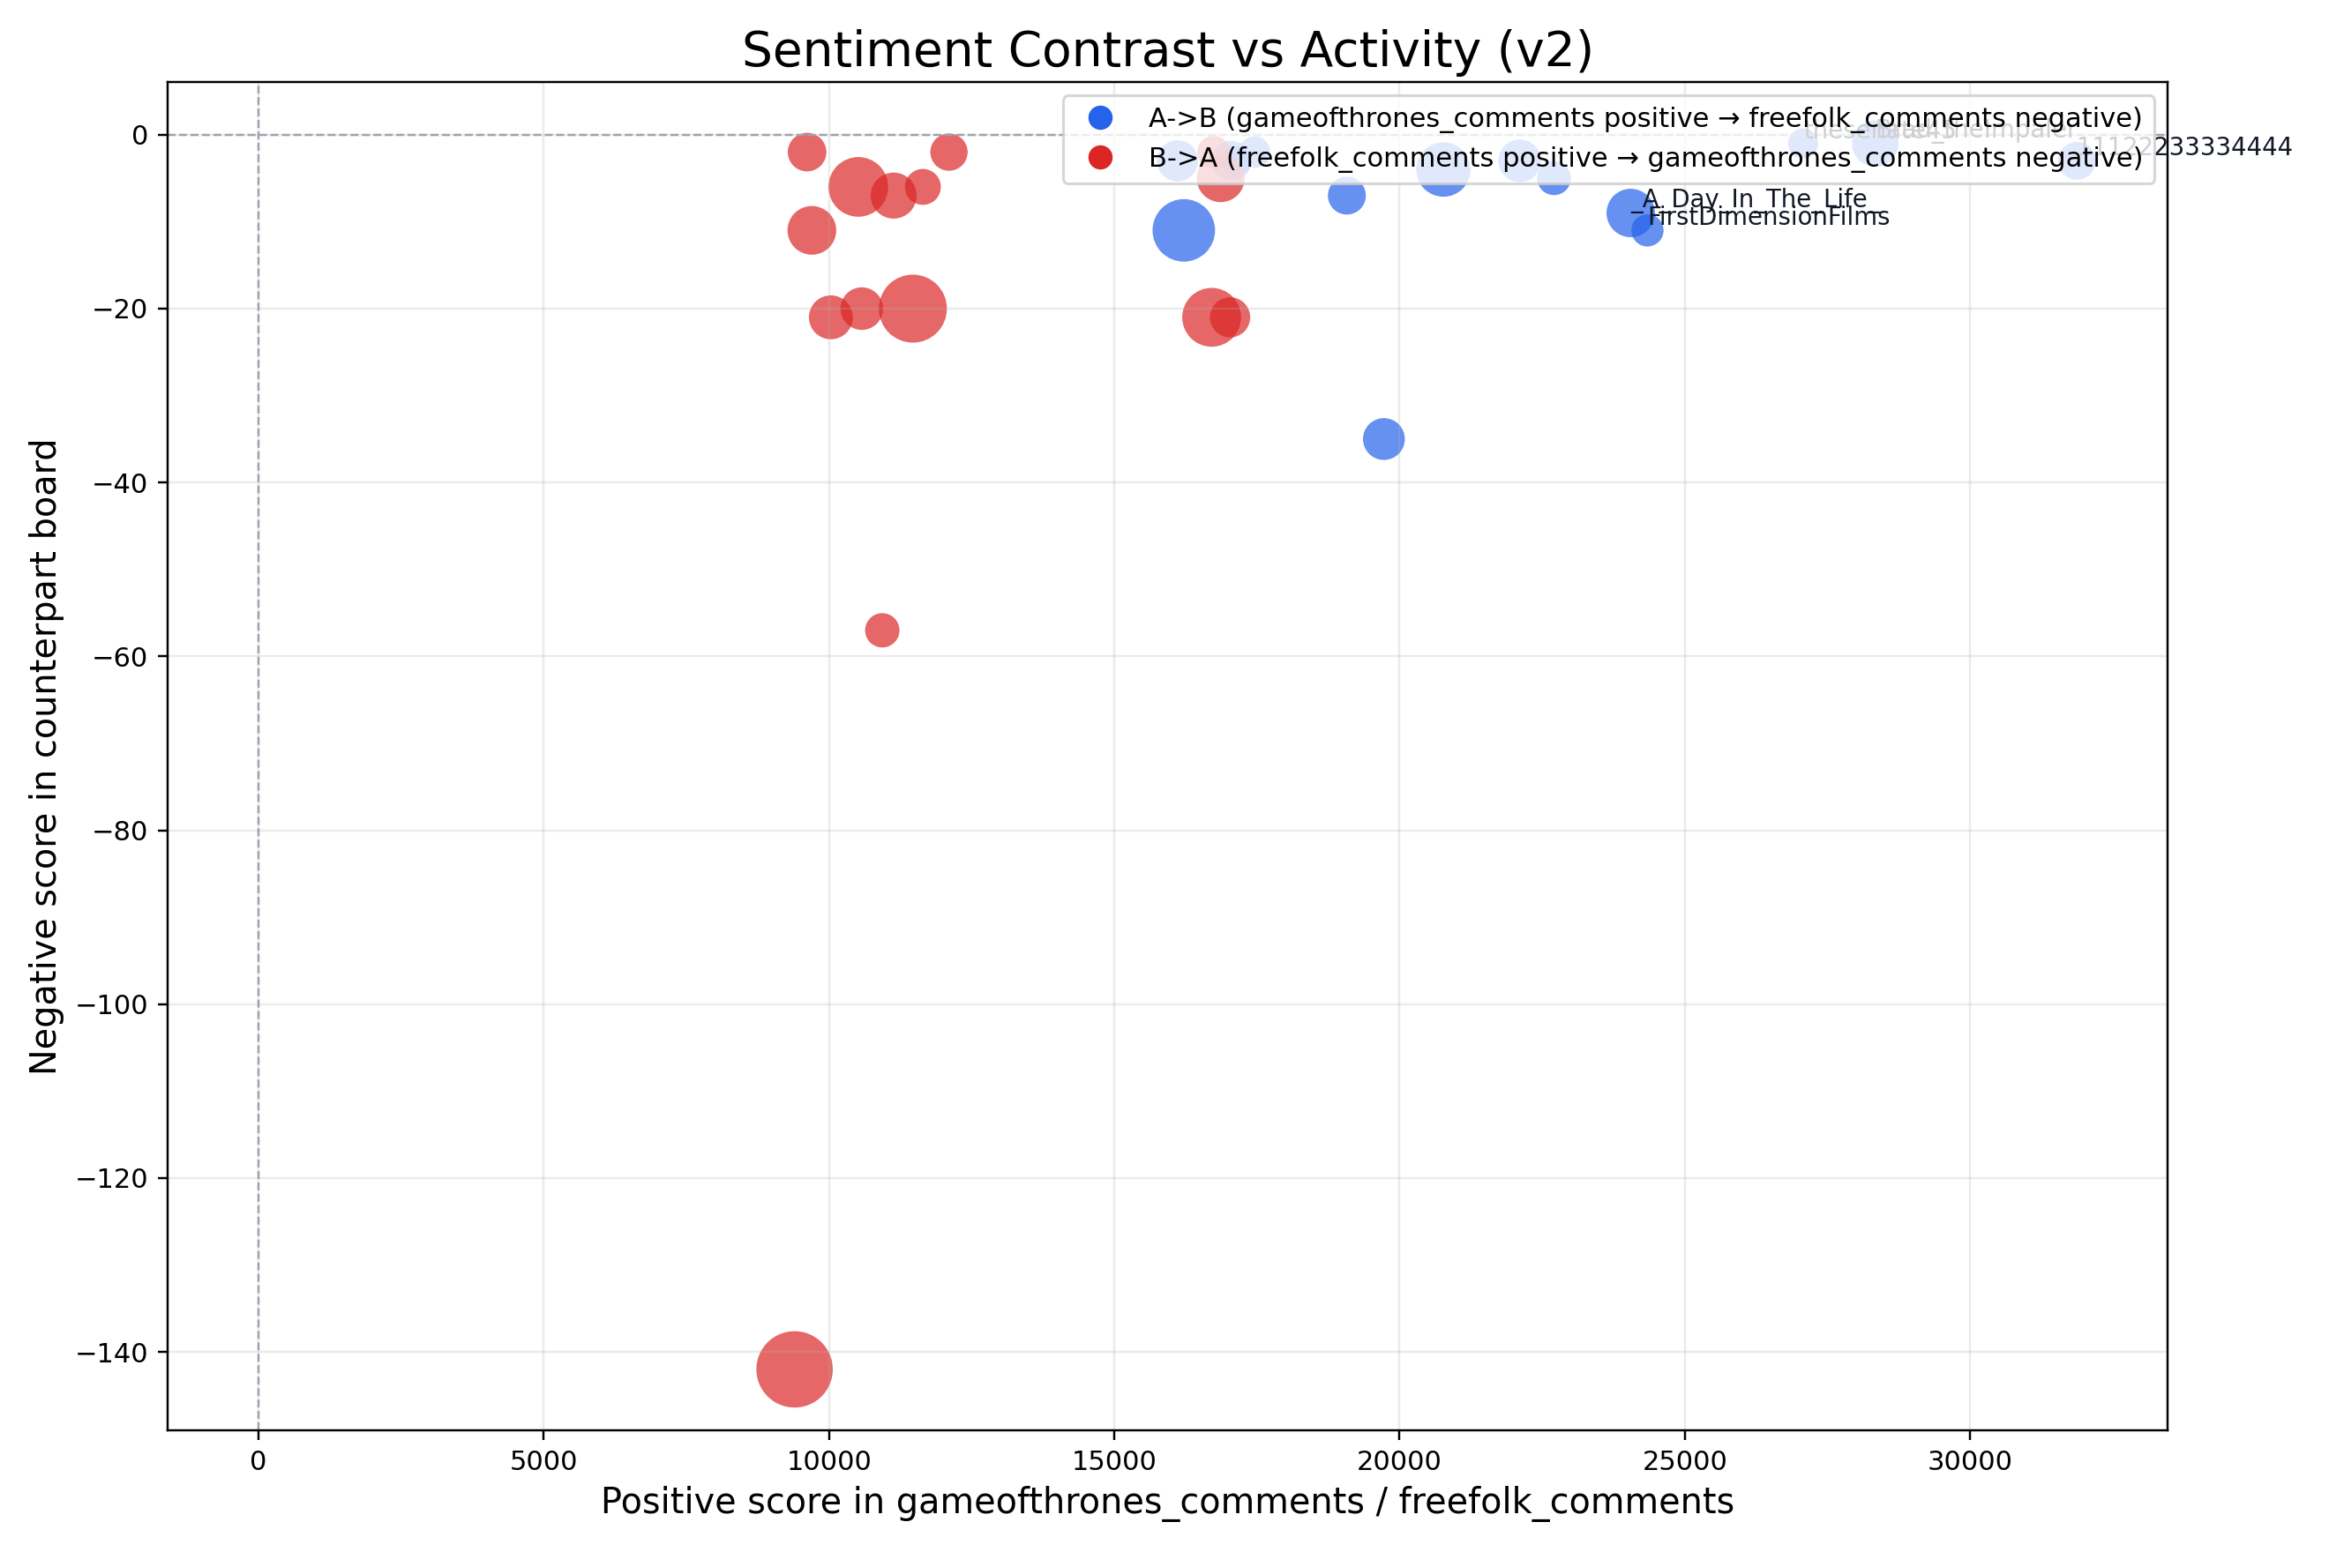
Sentiment contract

Slide 12
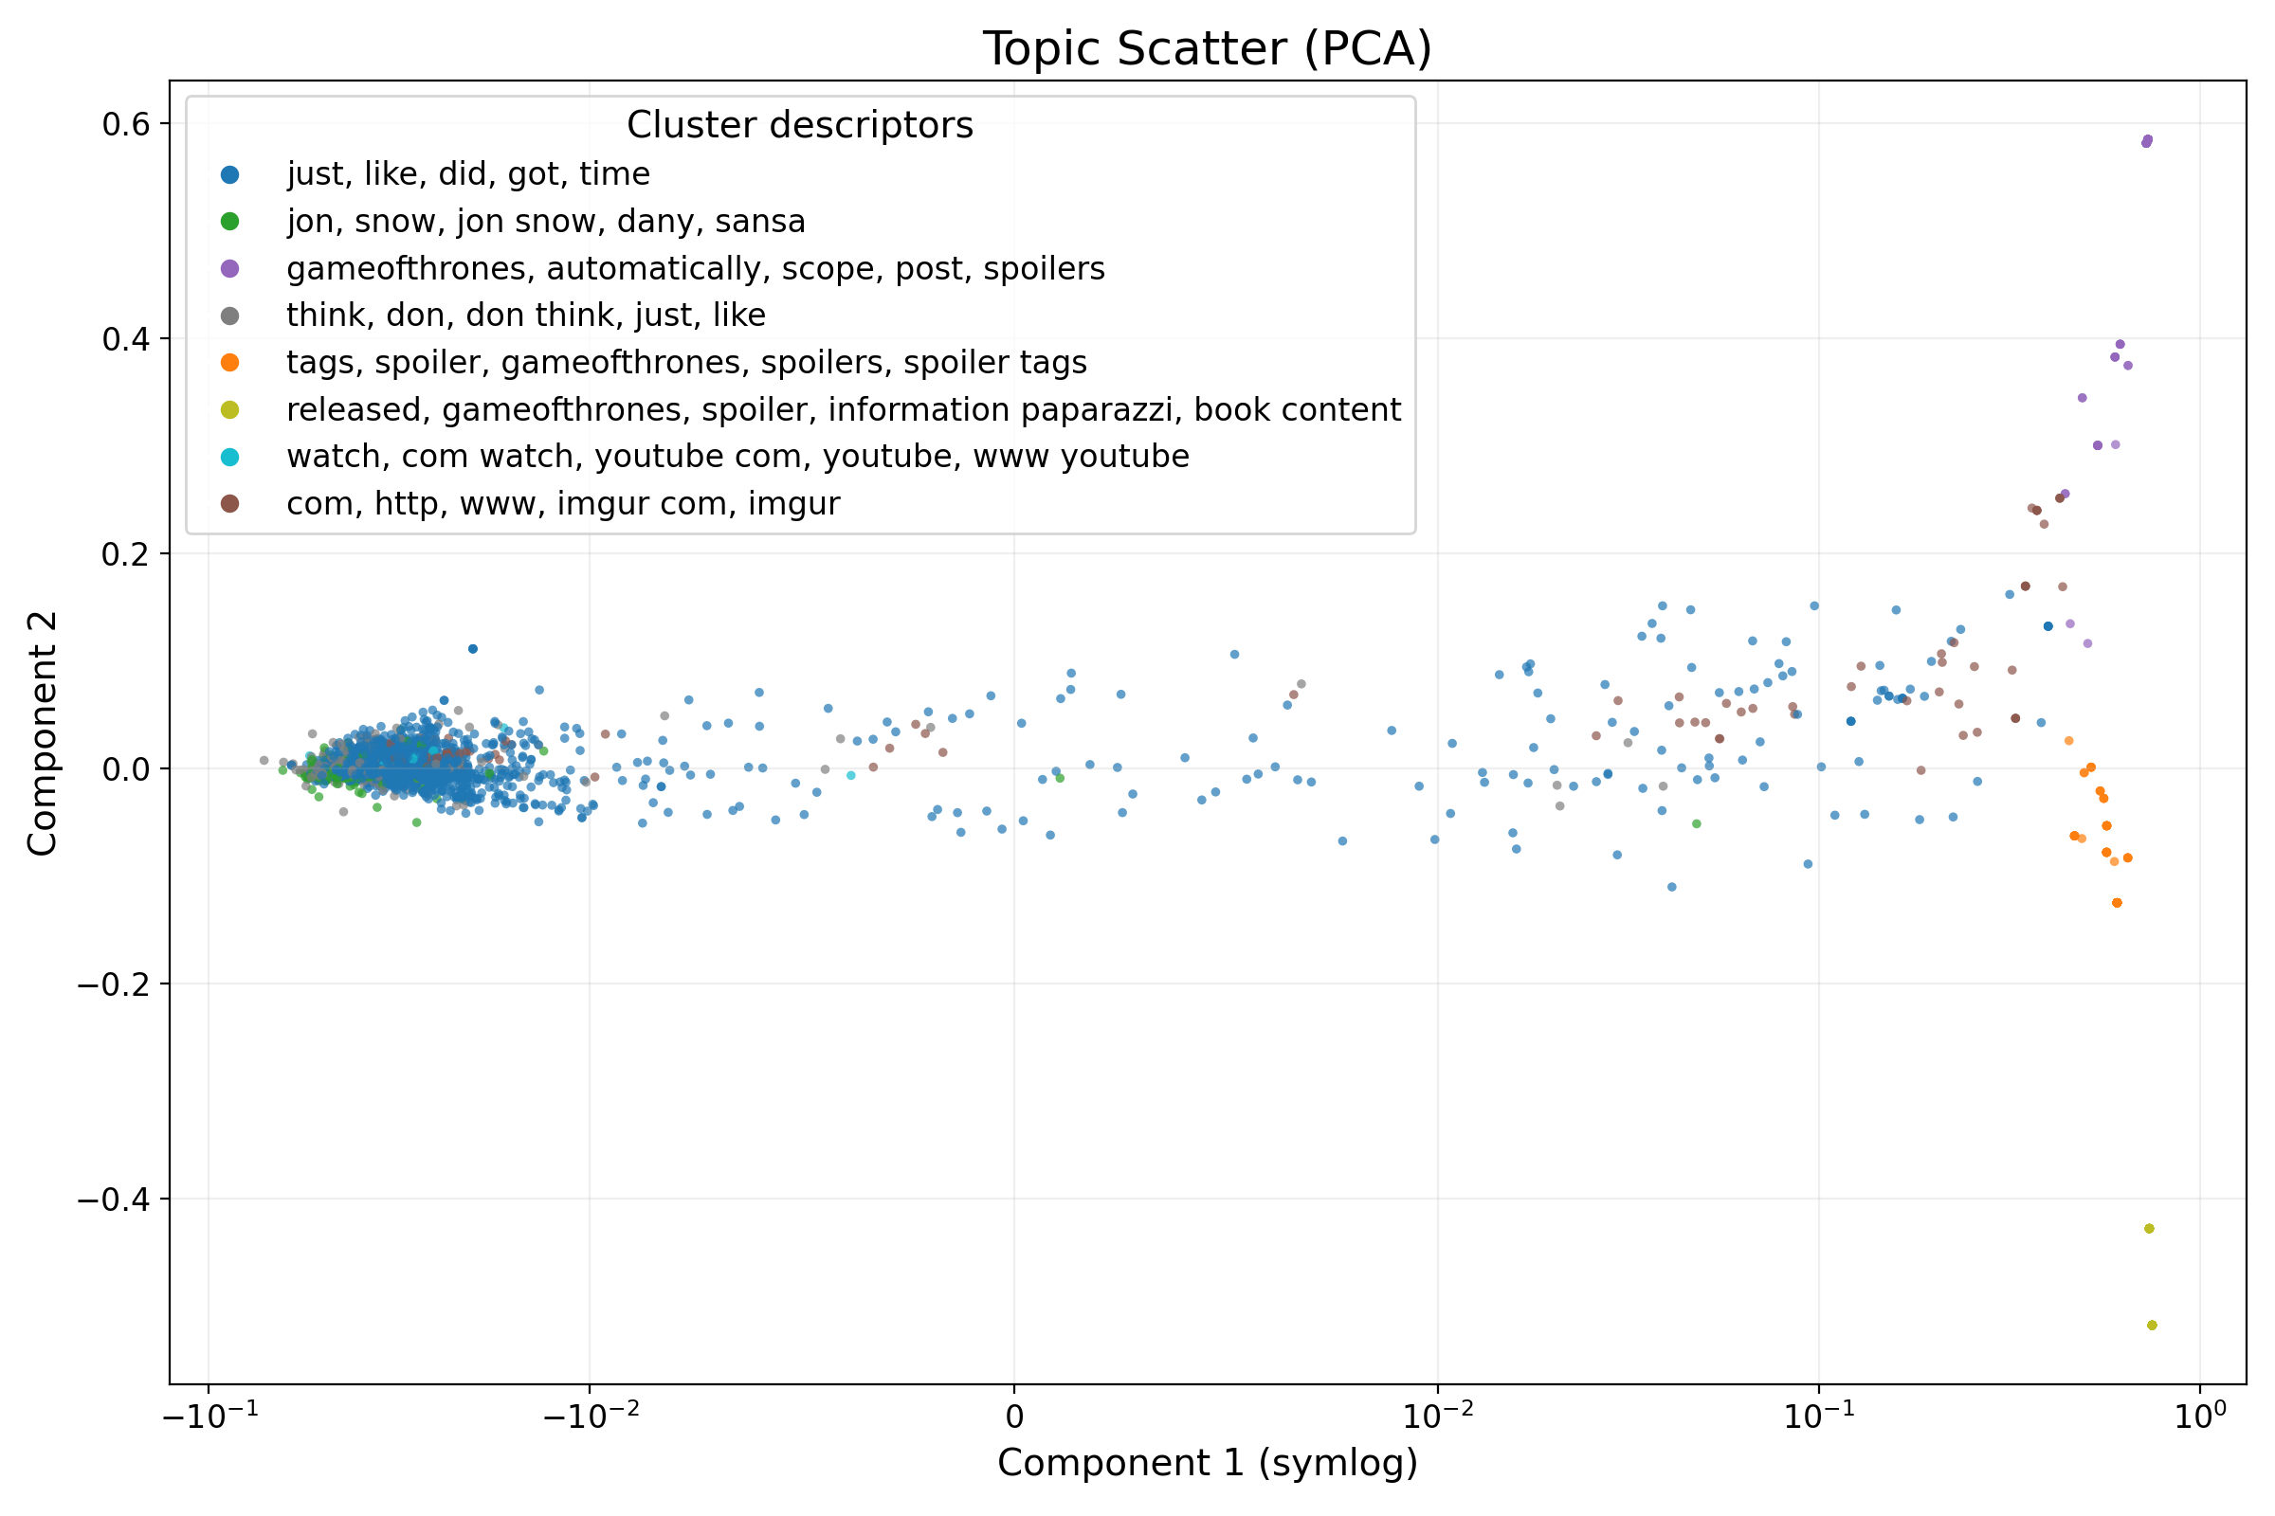
Topic

Slide 13
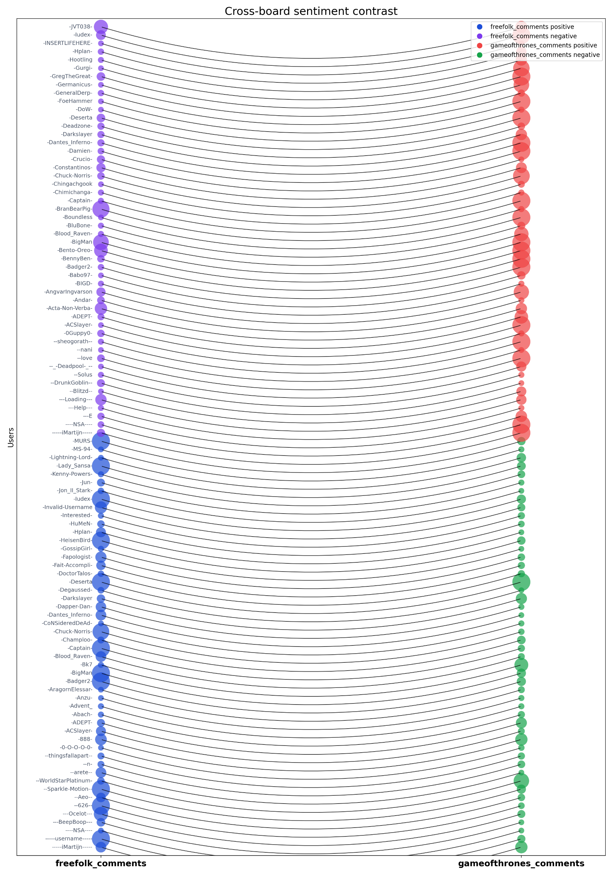

Slide 14
Thank you for your attention

